Slide 1


Notes:
use this sheet to open your presentation

Slide 2

PreFigure for creating tactile mathematical diagrams
David Austin, Grand Valley State University
Alexei Kolesnikov, Towson University
Tactile Reading and Graphics Conference
June 3, 2025
Note: This is a PowerPoint version of the slides. There is a web version of the talk available here: gvsu.edu/s/3cD

Slide 3
What is PreFigure?
PreFigure is an authoring system for creating accessible mathematical diagrams. PreFigure is to figures what PreTeXt is to text.
Open source and freely available.
Write once, read everywhere. From the same source, PreFigure creates
annotated SVG for HTML,
PDF for print,
tactile graphics for embossing,
more ….

Slide 4
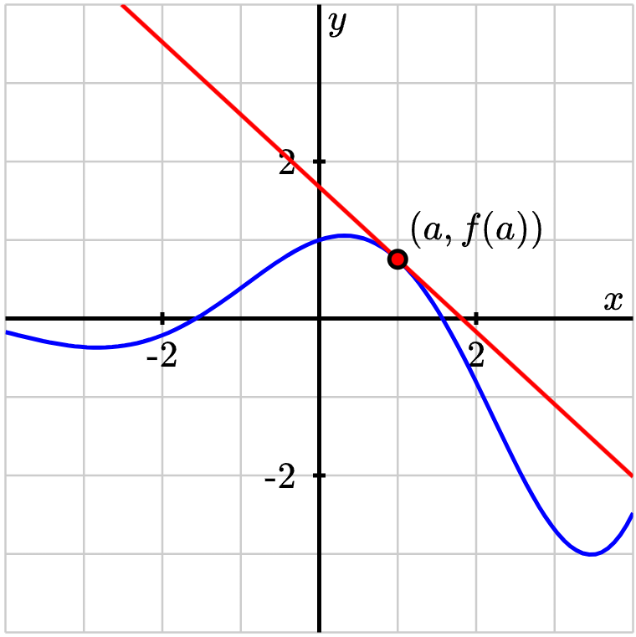
Annotated diagrams – web
Figure 1. An annotated diagram created with PreFigure.
The HTML version of the slides allows the reader to navigate the verbal annotation of diagram, exploring the various elements: axes and grid; graph of a function and tangent line.

Slide 5
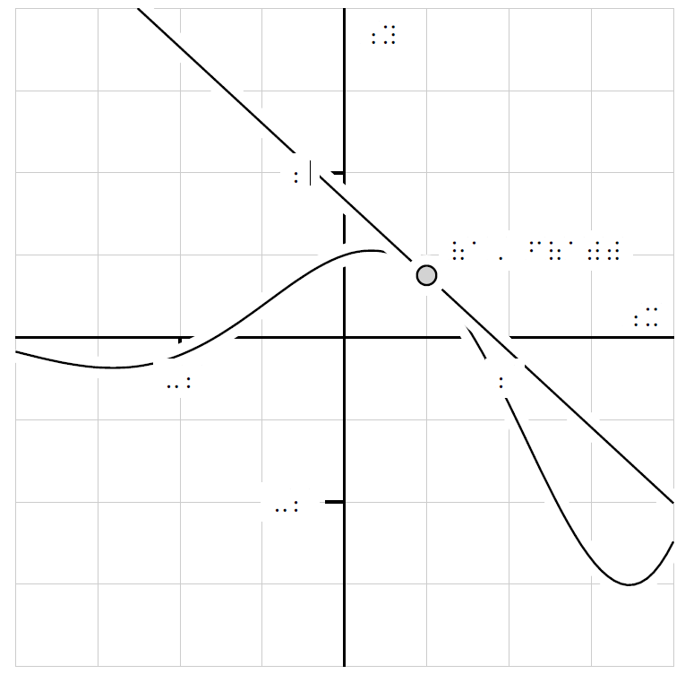
Annotated diagrams – tactile
Foreground components have a clear outline.
MathJax produces mathematics in Nemeth Braille.
Labels are rendered in the Braille29 font to facilitate embossing.

Slide 6
Anatomy of a PreFigure diagram
PreFigure source is written in XML.
The next slide contains an example of the PreFigure XML code for the diagram we saw on the previous slides.

Slide 7
<diagram dimensions="(300,300)" margins="5">
<definition>a=1</definition>
<definition>f(x)=exp(x/3)*cos(x)</definition>
<coordinates bbox="[-4,-4,4,4]">
<grid-axes xlabel="x" ylabel="y"/>
<graph function="f"/>
<tangent-line function="f" point="a"/>
<point p="(a, f(a))"> <m>(a,f(a))</m> </point>
</coordinates>
</diagram>

Slide 8
Mathematical diagrams
PreFigure, an authoring system for accessible mathematical diagrams, is to figures what PreTeXt is to text. (Workshop tomorrow at noon!)
Standalone software yet fully integrated into PreTeXt.
From a single source, an author can create annotated SVGs, PDFs, and tactile diagrams.

Slide 9
Getting started with PreFigure
PreFigure playground, thanks to Jason Siefken, gvsu.edu/s/35f.
PreFigure codespace, gvsu.edu/s/35e
PreTeXt codespace
Install locally from instructions at prefigure.org

Slide 10
Your turn
PreFigure documentation: prefigure.org
In the Playground, (gvsu.edu/s/35f) modify the original diagram:
Change the aspect ratio with dimensions="(300,200)"
Change the bounding box with bbox="(-1,-2,4,5)"
Change the function f or the point a where the tangent line is drawn.
Add another function and include stroke="green".
Add another point with a label.

Slide 11
Your turn, continued
PreFigure documentation: prefigure.org
PreFigure Playground: gvsu.edu/s/35f
Recreate one of the tactile samples.
Explore samples in the Examples link in the Playground.

Slide 12


